Slide 1

CPE 490 Embedded Systems Lecture 5
Standard and C30 Specific Libraries 14.4, 14.8
Files produced by Compiler 14.5
Example program Fibonacci program 14.7

Slide 2
Ternary Operator
Replaces
If(condition)
expression;
else
expression;
With
Exp1 ? Exp2: Exp3
Example
if count(>0) done=0;
else done = 1;
OR
done = count>0 ? 0 : 1

Slide 3
Standard Libraries
Need for more functions because of the simplicity of C
Library = set of precompiled functions, in the form of object files that can be linked to your source files
ANSI has defined a set of standard C libraries.

Slide 4
Standard Libraries Include Standard Headers
Each Standard Library is associated with a header file
Header file contains one or more function declarations, data type definitions and macros.
Some will not make sense in an embedded system like ‘printf’ unless a ‘file’ has been opened like a UART port then a ‘stream’ of data can be sent

Slide 5
Example of Standard Headers
• <assert.h> diagnostics
• <ctype.h> character handling
• <errno.h> errors
• <float.h> floating-point characteristics
• <limits.h> implementation-defined limits
• <locale.h> localization
•<math.h> math routines
•<setjmp.h> non-local jumps zation
• <signal.h> signal handling
• <stdarg.h> variable argument lists
• <stddef.h> common definitions
• <stdio.h> input and output
• <stdlib.h> utility functions
• <string.h> string functions
• <time.h> date and time functions

Slide 6
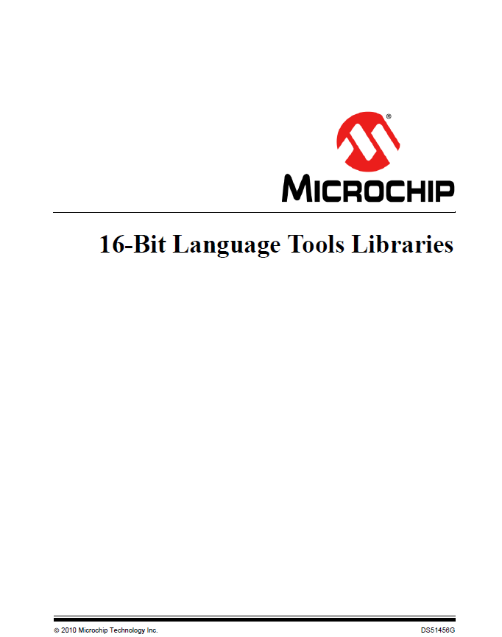
Documentation for Standard Library Functions
On Blackboard under Lab Information -> Microchip Documents

Slide 7
Why Use a Library Function?
Say I need to calculate the cosine of an angle in my code.
Cosine is not a operator in C
Write my own – that would be painful
Remember that math.h has many functions like this
Go to the 16 bit language tool libraries document.

Slide 8
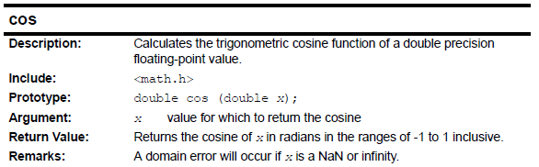
Finding a Library Function
In the TOC of the document I see Chapter 3. Standard C Libraries - Math Functions
Look up the cosine function I find:
Notes:
There is an example given in the document after the shown info in the slide.

Slide 9
Example of cos use
//Example of using standard math library to perform
//The cosine calculation
#include <p33FJ256GP710A.h>
#include <math.h>
int main (void) //main function starts here
{
double x,y;
while (1)
{
x = 3.124;
y = cos(x);
}
}
Notes:
Notice that it takes 2836 instruction cycles to calculate the COS of an angle

Slide 10
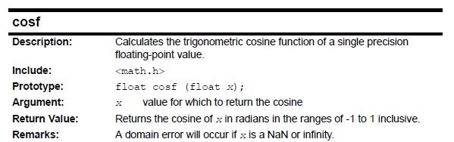
What about a Floating Point Cosine
We see from the document there is another function called cosf
Notes:
Note for our processor there is no difference between float and double

Slide 11
Non Standard Libraries
Fixed point math routines
#include <libq.h> /* include fixed point library */
Since the dsPIC33 does not have hardware for floating point numbers if you can break a number into two parts and integer part and a fractional part
The library will run much faster than doing floating point numbers math in the standard C library.

Slide 12
Non Standard Libraries
DSP routines
#include <dsp.h> /* include fixed point library */
Standard C can not take advantage of the DSP MAC
Very efficient Assembly codes is used to write these functions. Unlocks the power of the DSP
Function include matrix, vector, filtering, Control functions (PID)
Help available from install of xc16
C:\Program Files\Microchip\xc16\1.21\docs\dsp_lib

Slide 13
Non Standard Libraries
Hardware peripheral functions
#include is specific to a number of different libraries like:
ADC, Output compare, I2C, SPI, UART. LCD module, Motor control, Input Compare, Timer, and DMA
Still can program through the SFRs but usually easier, more visible, and reliable to use library function calls.
To see help files go to C:\Program Files\Microchip\xc16\v1.21\docs\periph_lib

Slide 14
Example HW Peripheral Library Function
See mainlibtime.c
Using these functions avoids having to code bit patterns into SFRs.
I would like to add a function that starts the timer and one that stops it.
Opentimer1.c and timer.h are given on BlackBoard under this lecture.

Slide 15
XC16 Compiler
Creates assembly code that can be linked with other assembly modules and object code from libraries. Same assembler and linker is used for writing assembly language code
Compiler is an ANSI x3.159-1989-compliant, optimizing C compiler.
Compiler is a port of the GCC compiler from the Free Software Foundation

Slide 16
Compiler Non ANSI Extensions
Gives a set of attributes that are defined in the GNU compiler, but not in standard ANSI
Gives the ability to set attributes life SFR or far and near that take into account the memory architecture of the target
Gives ability to locate interrupt routines
See compile user guide on BlackBoard for detailed explanation.

Slide 17
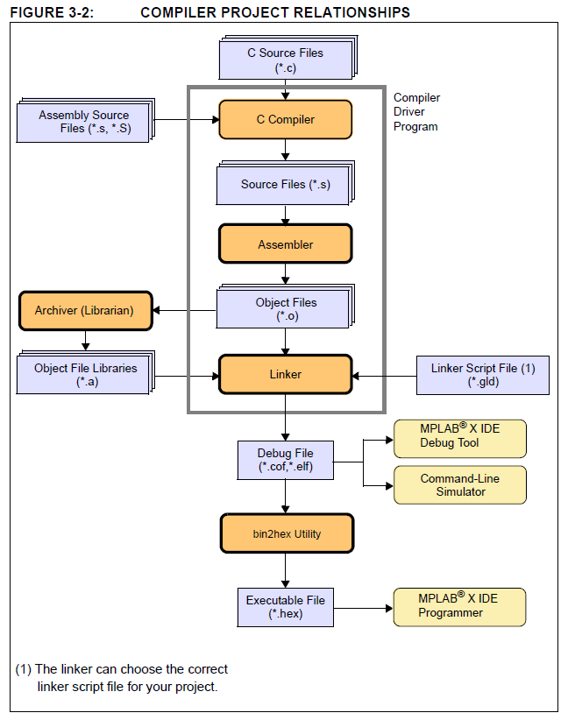
Tool Chain flow
Notes:
Exe is really HEX file
COFF Common object File Format file allows debugging to occur

Slide 18
Outputs of the Compile Process
Source file (.c)
COFF object module file (.cof) The file provides debugging information for MPLAB IDE
Executable file (.hex) the bit patterns that will go into program memory
Object File (.0) contains relocatable code.
Map File (.map) locations of code in program memory, location of variables in data memory

Slide 19
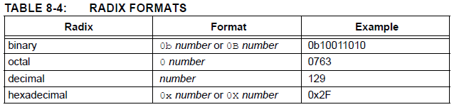
Radix short hand
Notes:
Note 0 is zero never the letter

Slide 20
do while loops
do {
Statements
} while (condition);
Loop will run at least once.

Slide 21
Fibonacci Program
See program example 14-2 in the book
Mistakes
Void return on main
Counter < 12 could be Counter <13 and not violate char size.
Notes:
At this point you should understand this program.

